Slide 1


LOW RESOURCE ASR: HOW CAN “DONOR DATA” IMPROVE PERFORMANCE?
Presented by Sohini Roy

Slide 2
OVERVIEW
Introduction
Result
Background
Discussion
Data
Conclusion
Methodology
References

Slide 3
INTRODUCTION
There are over 200 million speakers worldwide of Dravidian languages, yet relatively so little documentation for most. The majority of the speakers are located in South India
Malayalam is a lower-resource Dravidian language with over 30 million speakers worldwide, native to the South Indian state of Kerala
Only a handful of usable open-source speech corpora available online
Can supplementing a lower resource target language with typologically-similar “donor data” from a higher-resource language improve performance in ASR?

Slide 4
BACKGROUND
Malayalam is one of the four main literary Dravidian languages, alongside Tamil, Telugu, and Kannada
Tamil and Telugu are relatively higher-resourced with over 80 and 90 million speakers respectively

Slide 5
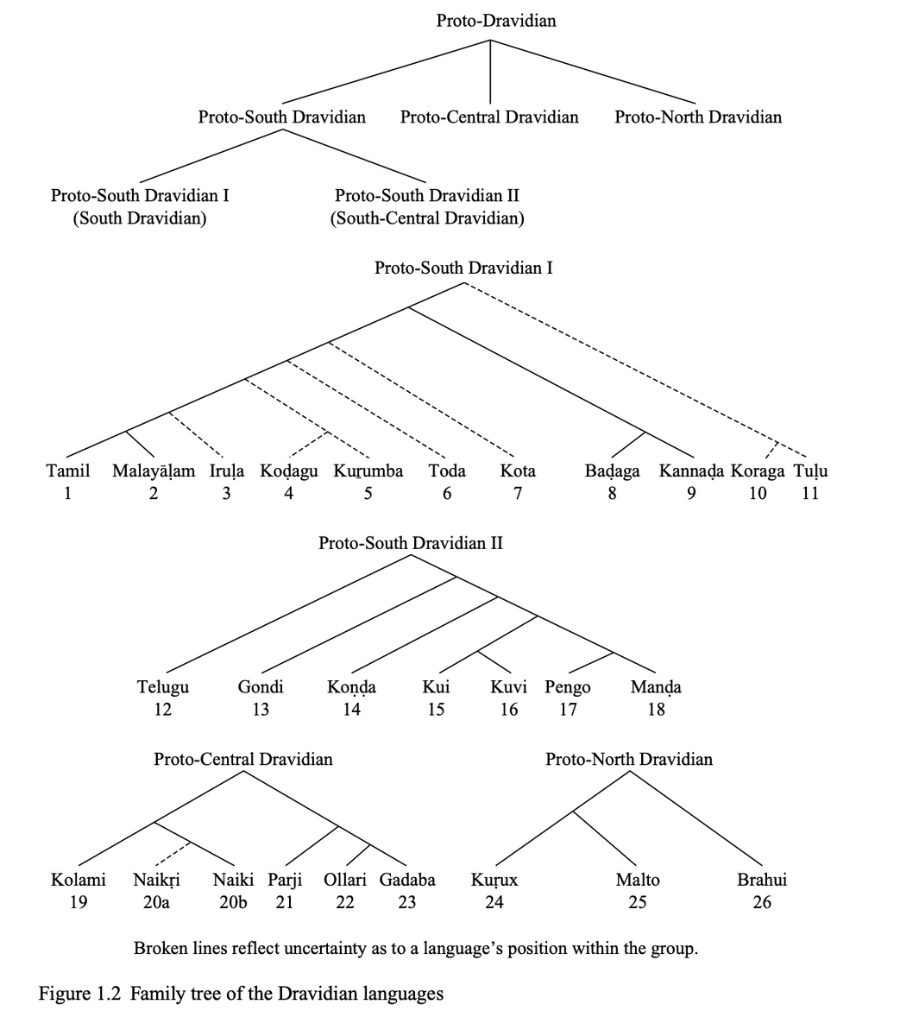
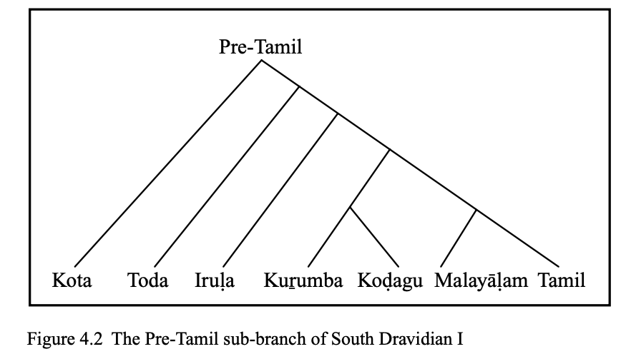
BACKGROUND

Slide 6
DATA
Sourced most of my data from IndicSUPERB corpus (Javed et al., 2023)
Dataset of 12 Indic languages containing 65–180 hours of read speech per language
119 speakers
Telugu, Tamil, Kannada
Malayalam data sourced from IMaSC (ICFOSS Malayalam Speech Corpus) (Gopinath et al., 2022)
Approximately 50 hours of Malayalam sentences spoken by 8 speakers

Slide 7
METHODOLOGY
Model: wav2vec2-xls-r-300m from Facebook
Pretrained on 436k hours of unlabeled speech from 128 languages
Objective: Pre-train wav2vec 2.0 with different amounts of target + donor data, and fine-tune on the same three hour subset of labeled Malayalam data to analyze its effects
BASELINE
10 hours Malayalam
ADDITIONAL
10 hours Malayalam + 20 hours Tamil
10 hours Malayalam + 20 hours Kannada
10 hours Malayalam + 20 hours Telugu
30 hours Malayalam
30 hours Malayalam + 20 hours Tamil
30 hours Malayalam + 20 hours Kannada

Slide 8
PRE-TRAINING VS. FINE-TUNING?
Pre-training
Self-supervised technique i.e., does not require labeled data
Expands knowledge base by training on hours of raw data to learn the audio structure, temporal patterns (syllables, pauses), speaker-independent phoneme features, and acoustic properties of human speech
Fine-tuning
Supervised technique i.e., requires labeled data (text-audio pairs)
Uses the pre-trained weights along with a CTC (Connectionist Temporal Classification) layer to align audio frames to characters or subwords even if the alignment isn’t known
Learns language-specific sound-to-symbol mapping

Slide 9
METHODOLOGY
Started with Tamil pre-training first
Significantly higher-resource than Malayalam
Malayalam was originally considered a dialect of Tamil and gradually evolved into a distinct language.
Calculated metric similar to ATDS (Acoustic Token Distribution Similarity) as a measure of typological similarity
Pre-trained on Kannada and Telugu as well to see if measures correlated with ATDS
Malayalam is an agglutinating language
While evaluating, WER results were extremely bad
Used CER as a metric instead

Slide 10
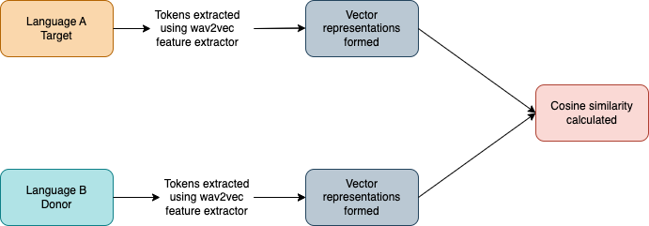
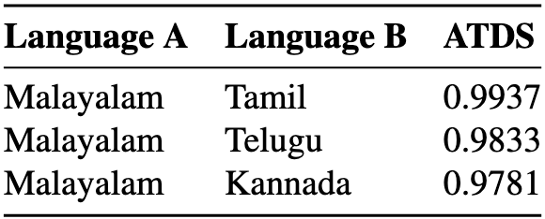
WHAT IS ATDS?
Acoustic Token Distribution Similarity is a similarity metric developed by (Nay San et al., 2024)
Authors expanded upon the Token Distribution Similarity metric developed by (Wu et al., 2021)

Slide 11
RESULTS
--- Reference ---
Malayalam: സർവ്വകലാശാല വൈസ് ചാൻസലർ ഡോ. ചന്ദ്രബാബുവിനും സംഭവം തലവേദനയാവുകയാണ്
Romanized: savvakalAshAla vais chAsala Do. chandrabAbuvinuM saMbhavaM talavedanayAvukayAN
--- Prediction ---
Malayalam: സർവലാശാല വൈിസ്ചൺസിലർ ഡക്ടർഷ്ചണ്ഡ്ര ബാബുവനും സംഭവം തലവേതന്യാവുഗയാണ്
Romanized: savalAshAla vaiischasila DakTaShchaNDra bAbuvanuM saMbhavaM talavetanyAvugayAN

Slide 12
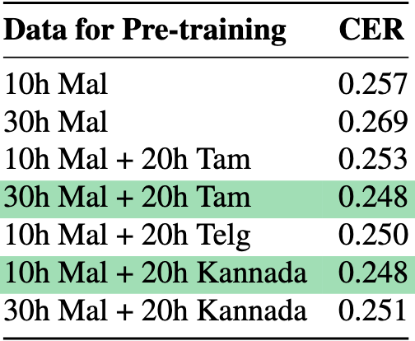
RESULTS
All donor models performed better than baseline
10h Malayalam + 20h Kannada performed better than 10h Malayalam + 20h Tamil
30h Malayalam + 20h Tamil performed better than 30h Malayalam + 20h of Kannada
30 hours of Malayalam did the worst
However, ATDS does not seem to be an accurate way of predicting this- at least, not for CER

Slide 13
DISCUSSION
10 hours of Malayalam + 20 hours of Kannada performed better than 10 hours of Malayalam + 20 hours of Tamil
With just 10 hours of the target language, Tamil may have dominated the representations too much and caused the model to overfit or converge too tightly on certain patterns
Kannada may have worked well as an alternate because it’s less similar in terms of vocabulary, phonetics, and genetic history, but it was descended from the same ancestral subgroup
30 hours of Malayalam + 20 hours of Tamil performed better than 30 hours of Malayalam + 20 hours of Kannada
Cross-lingual transfer helps generalization
30 hours of Malayalam did the worst- perhaps not enough speaker variety?
However, ATDS does not seem to be an accurate way of measuring this in advance- at least, not for CER

Slide 14
CONCLUSION
Cross-lingual transfer does seem to be beneficial
Much of this seems to be dependent on quantity of data/ratio of target data to donor data
Perhaps a larger ratio like 10 hours target language + 60 hours donor language would correlate more with ATDS?
If supplementing with a larger quantity of donor data than target data, a language that is too genetically similar may overrepresent certain patterns

Slide 15
FUTURE WORK
Stepping stone to work on even lower-resourced languages in the future- ones that models today do not encompass whatsoever
Try greater ratios of target-to-donor data
Could be worth it to try multi-lingual data as supplementary data as well?

Slide 16
REFERENCES
Nay San, Georgios Paraskevopoulos, Aryaman Arora, Xiluo He, Prabhjot Kaur, Oliver Adams, and Dan Jurafsky. 2024. Predicting positive transfer for improved low-resource speech recognition using acoustic pseudo-tokens. In Proceedings of the 6th Workshop on Research in Computational Linguistic Typology and Multilingual NLP.
David M. Eberhard, Gary F. Simons, and Charles D. Fennig, editors. 2025. *Ethnologue: Languages of the World*, twenty-eighth edition. Dallas, Texas: SIL International. Online version: http://www.ethnologue.com.
Bhadriraju Krishnamurti. 2003. The Dravidian Languages. Cambridge University Press, 1st ed.
Tahir Javed, Kaushal Bhogale, Abhigyan Raman,Pratyush Kumar, Anoop Kunchukuttan, and Mitesh M. Khapra. 2023. IndicSUPERB: A speech processing universal performance benchmark for Indian languages. In Proceedings of the Thirty-Seventh AAAI Conference on Artificial Intelligence and Thirty-Fifth Conference on Innovative Applications of Artificial Intelligence and Thirteenth Symposium on Educational Advances in Artificial Intelligence, AAAI’23/IAAI’23/EAAI’23. AAAI Press.
Deepa P Gopinath, Thennal D K, Vrinda V Nair, Swaraj K S, and Sachin G. 2022. IMaSC -- ICFOSS Malayalam Speech Corpus.
Peter Wu, Jiatong Shi, Yifan Zhong, Shinji Watanabe, and Alan W Black. 2021. Cross-Lingual Transfer for Speech Processing Using Acoustic Language Similarity. In 2021 IEEE Automatic Speech Recognition and Understanding Workshop (ASRU), pages 1050–1057, Cartagena, Colombia. IEEE.

Slide 17
Thank You!
Questions?

